Slide 1


Slide 2
EVAPCO EUROPE BVBA
Open Type
Counterflow Cooling Towers

Slide 3
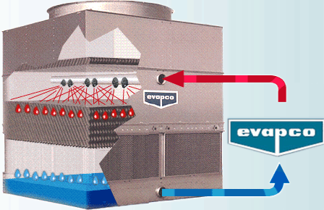
Principle of Operation
Counterflow Cooling Towers
Hot Saturated Discharge Air
Cool, Dry Air
Notes:
3

Slide 4
Counterflow Cooling Towers
Design Advantages
&
Product Features

Slide 5


Counterflow Cooling Towers
Thermal Performance Certification
Eurovent and CIT Certification: Capacity Guaranteed

Slide 6
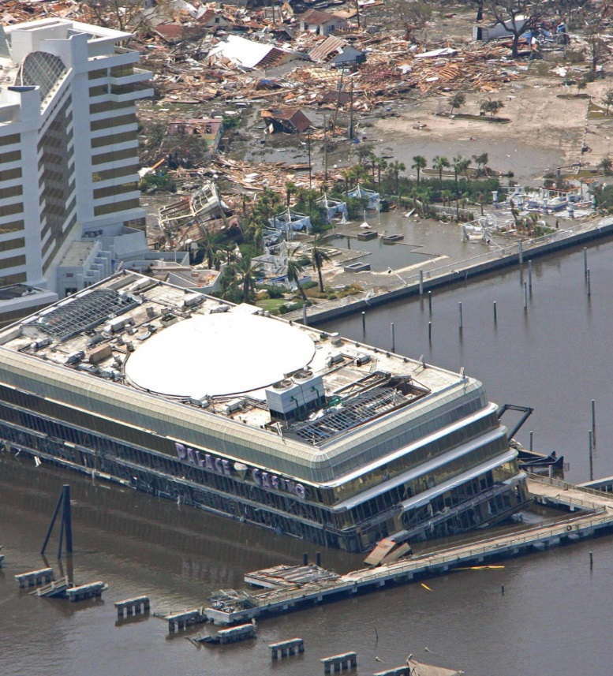
Counterflow Cooling Towers
IBC Compliant Design
EVAPCO Cooling Towers…designed to
withstand seismic or wind load forces

Slide 7
Counterflow Cooling Towers
IBC Compliant Design
What is IBC?
  The International Building Code requires that equipment must meet the same seismic or wind load forces as the building to which they are attached
How Does it Apply?
  Based on project location and site design factors, calculations are made to determine the equivalent seismic “g force” and wind load on the unit

Slide 8
Counterflow Cooling Towers
IBC Compliant Design
What does EVAPCO offer?
  Standard Structural Design
    Projects with ≤ 1.0g seismic or 60psf wind loads
  Upgraded Structural Design for high seismic and wind loads area

Slide 9
Counterflow Cooling Towers
IBC Compliant Design
Independent, 3rd Party Certification

Slide 10
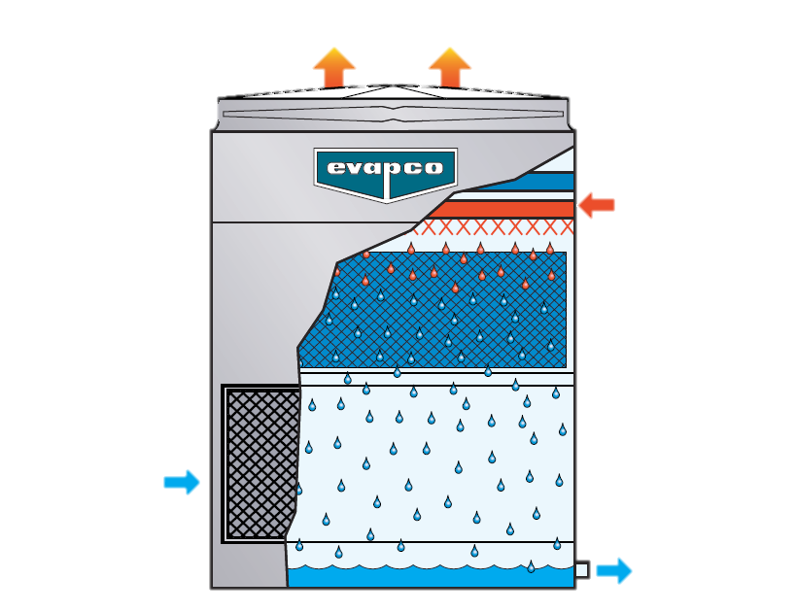
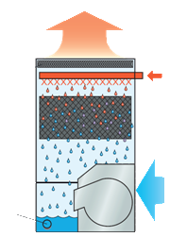
Counterflow Cooling Towers
Hot Saturated Discharge Air
Hot Saturated Discharge Air
Hot Water In
Hot Water In
Cool Dry Entering Air
Cool Dry Entering Air
Cooled Water Out
Cooled Water Out
AT
Induced Draft
LSTE
Forced Draft

Slide 11

Cooling Tower Hygiene
Eurovent 9/7
RECOMMENDED CODE OF PRACTICE TO KEEP YOUR COOLING SYSTEM EFFICIENT AND SAFE
Maintaining System Efficiency
Maintaining Equipment Safety
Annexe 1: Water Quality Requirements
Annexe 2: Cooling System Logbook

Slide 12
AT
Induced Draft
Counterflow Cooling Towers

Slide 13
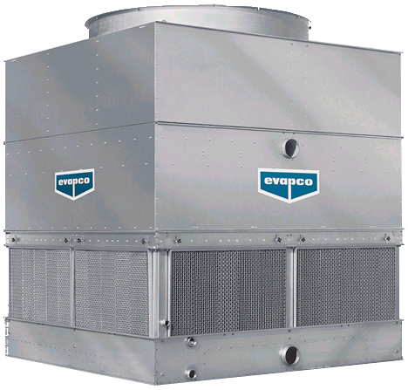
Product Range – AT/UAT Cooling Towers
AT Induced Draft Counterflow Cooling Towers
Advanced Technology
Ultra AT-
Full Stainless Steel
139 – 22.100 kW

Slide 14
Nomenclature - AT/UAT Cooling Towers
AT Induced Draft Counterflow Cooling Towers
AT-112-3N14
AT | - | Advanced Technology
1 | - | # of Cells
12 | - | Width of Unit (feet)
3 | - | Capacity Designator
N | - | Motor Size
14 | - | Length of Unit (feet)

Slide 15
AT Induced Draft Counterflow Cooling Towers
Signature Features – Materials of Construction
EVAPCO Corrosion Protection System
Z725 Galvanized Steel
PVC Distribution System
PVC Inlet Louvers
PVC Drift Eliminators
Stainless Steel Strainers

Slide 16
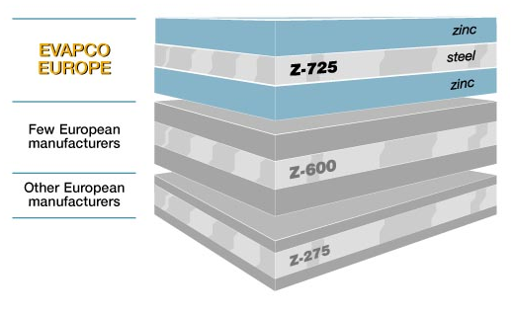
Counterflow Cooling Towers
Signature Features – Z-725 Hot Dip Galvanized Steel
Superior Corrosion Protection !
  725 g of Zinc per m²
  Highest in Industry

Slide 17
AT Induced Draft Counterflow Cooling Towers
Signature Features – Materials of Construction
Advanced Material Option
Stainless Steel Lower Section
Type 304L and Type 316L Stainless Steel
Stainless Steel

Slide 18
AT Induced Draft Counterflow Cooling Towers
Signature Features – Materials of Construction
Advanced Material Option
Type 304L Stainless Steel Casing and Fan Deck
Type 316L Stainless Steel Basin
304L SS
316L SS

Slide 19
AT Induced Draft Counterflow Cooling Towers
Signature Features – Materials of Construction
Advanced Material Option
Complete 316L SS Construction
100% Corrosion Resistant
316L SS

Slide 20
Design Advantages – Most Efficient Heat Transfer
AT Induced Draft Counterflow Cooling Towers
35°C Entering Water Temperature
EVAPAK® Counterflow Fill:
Even Temperature Gradients through Fill Cross-section
Cools precisely to design temperature
Requires Less Air
Optimal Fill Location
34°C
Water Temp
Isotherms
32,5°C
31°C
30°C
Entering Air at 25,6°C Wet-Bulb Temperature
30°C Net
Outlet Water
Temperature

Slide 21
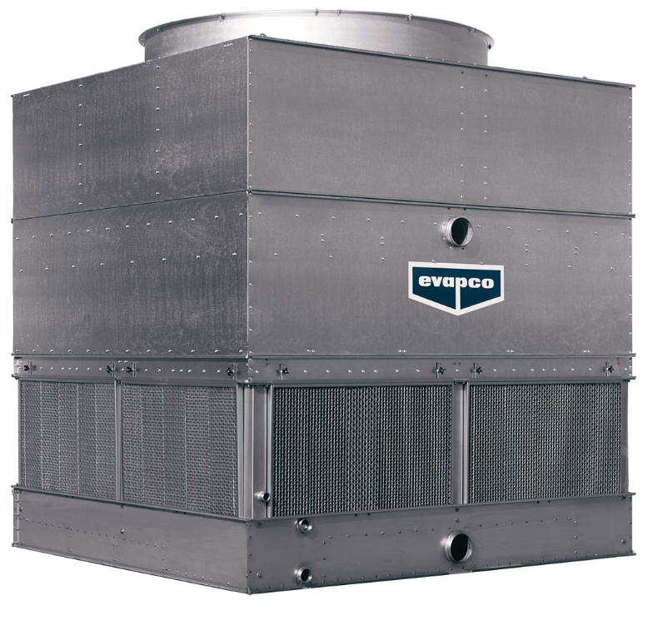
Design Advantages - Optimal Fill Location
AT Induced Draft Counterflow Cooling Towers
Completely encased in steel
Protected from direct exposure

Slide 22
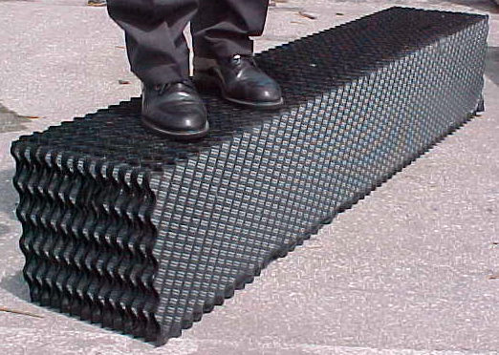
Counterflow Cooling Towers
Signature Features – Most Efficient Heat Transfer
EVAPAK® Fill
  Removable, bonded block construction
  Low pressure drop
  Bottom supported

Slide 23
Comparison – Crossflow Heat Transfer
AT Induced Draft Counterflow Cooling Towers
35°C Entering Water Temperature
35°C
Temperature Gradients
Not Uniform Across Fill
Some Water Not Cooled to Design Temperature
Allows air to bypass
Easily clogged, difficult to replace
33,5°C
32,2°C
Entering Air at 25,6°C
Wet-Bulb Temperature
31°C
29,5°C
27,8°C
29,4°C Net
Outlet Water
Temperature
26,5°C
Crossflow Fill

Slide 24
AT Induced Draft Counterflow Cooling Towers
Design Advantages – Winter Operation
18,5°C Entering Water Temperature
Temperature Gradients
7,2°C – 0°C = 7,2°C Safety
Unique Inlet Louver Design
10,5°C
Water Temp
Isotherms
12,8°C
10°C
7,2°C
Entering Air at -12°C Wet-Bulb Temperature
7,2°C Net
Outlet Water
Temperature
Counterflow Fill

Slide 25
Design Advantages – Winter Operation
AT Induced Draft Counterflow Cooling Towers
48,5°C Entering Water Temperature
17,8°C
15,5°C
Temperature Gradients
1,1°C – 0°C = Greater
Great Risk for Ice Formation
Ice Builds on Louvers & Fill
12,7°C
10°C
Entering Air at 10° F
Wet-Bulb Temperature
7,2°C
4,4°C
7,2°C Net
Outlet Water
Temperature
1,1°C
Crossflow Fill

Slide 26
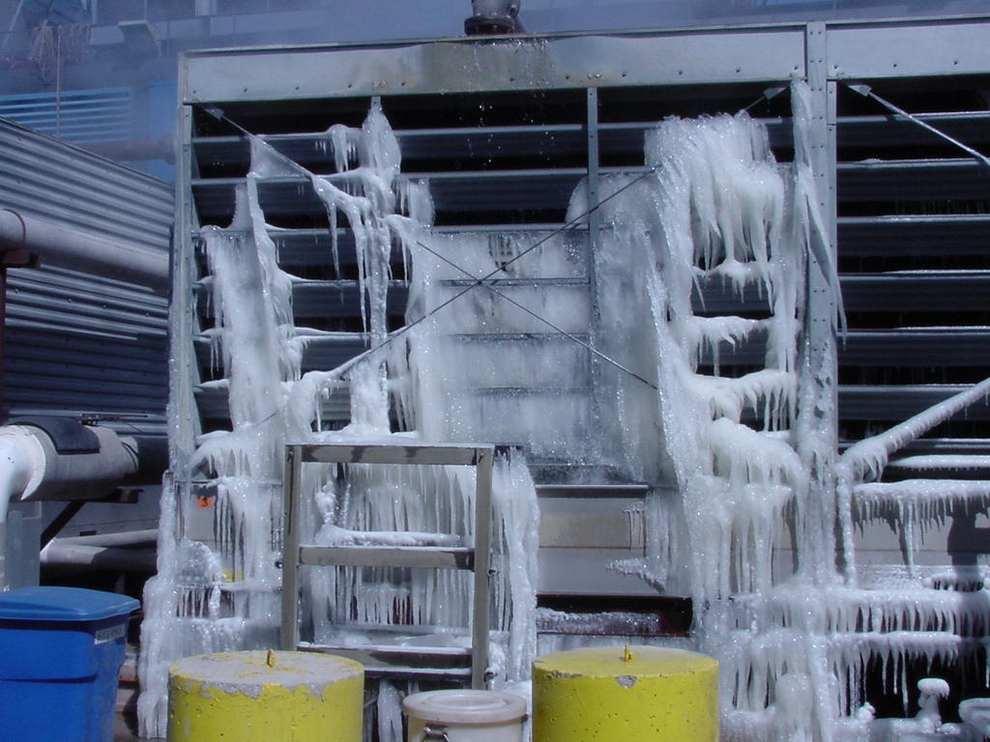
Design Advantages – Winter Operation
AT Induced Draft Counterflow Cooling Towers
Exposed Crossflow Fill:
Ice Formation
Ice Builds on Louvers & Fill

Slide 27
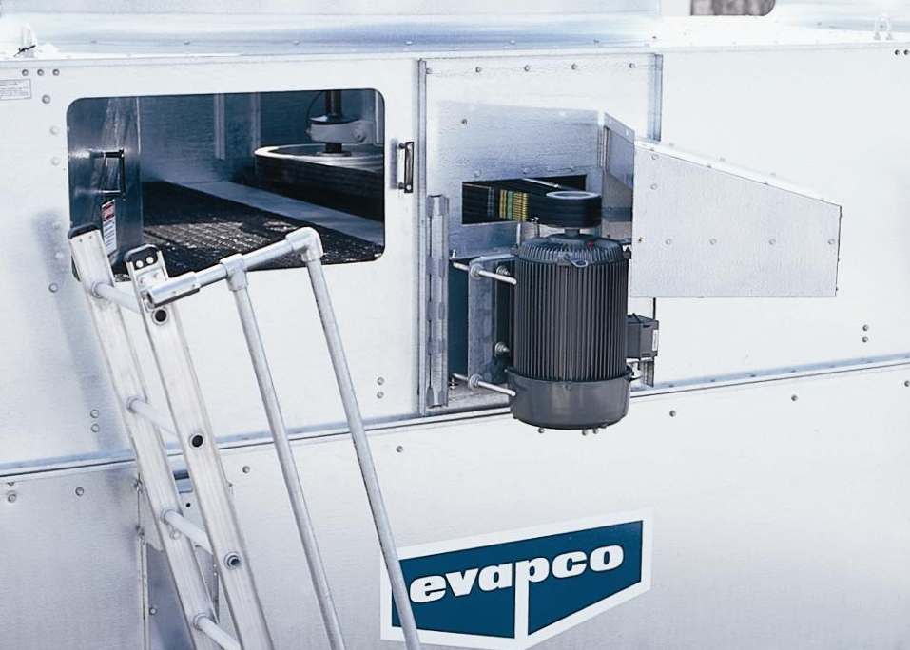
AT Induced Draft Counterflow Cooling Towers
Simplified Maintenance – Mechanical Drive System
Externally Mounted TEFC Motor
Power-Band Adjustment from Outside
Bearing Lubrication Lines Extended to Outside
2,4 m Wide Models

Slide 28
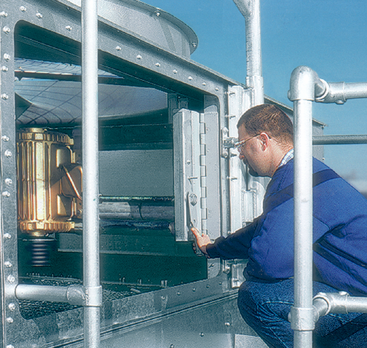
AT Induced Draft Counterflow Cooling Towers
Simplified Maintenance – Mechanical Drive System
Easy-Glide Motor Access Door
Easy Access Fan Belt Adjustment
Locking Mechanism Designed to Adjust Power-Band Belt Tension
3 m, 3,6m and 4,3 m Wide Models

Slide 29
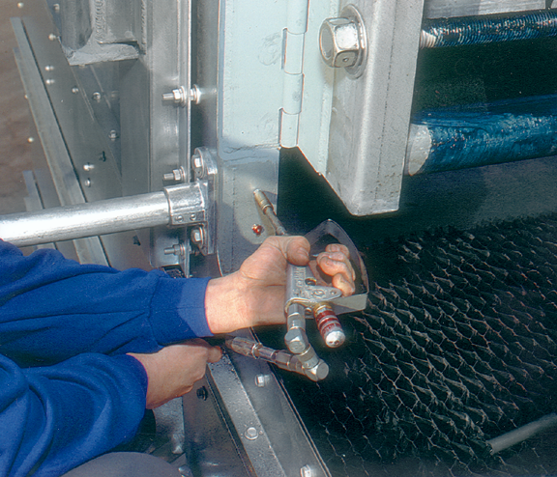
AT Induced Draft Counterflow Cooling Towers
Simplified Maintenance – Mechanical Drive System
Fan Bearing Lubrication from Outside the Unit
3 m, 3,6m and 4,3 m Wide Models

Slide 30
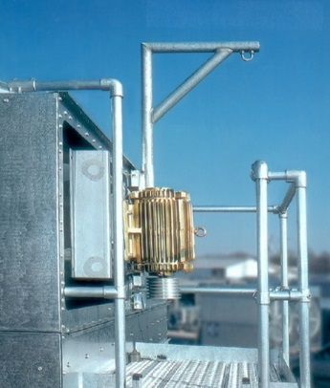
AT Induced Draft Counterflow Cooling Towers
Simplified Maintenance – Mechanical Drive System
Swing Out Motor Base for Easy Service
3 m, 3,6m and 4,3m Wide Models

Slide 31
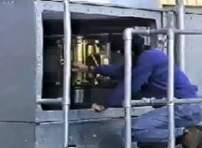
AT Induced Draft Counterflow Cooling Towers
Simplified Maintenance – Mechanical Drive System
Swing Out Motor Base for Easy Service
3 m, 3,6m and 4,3m Wide Models

Slide 32
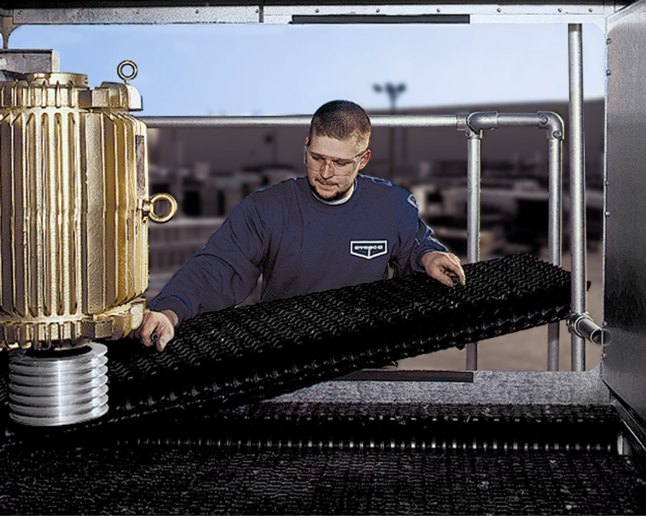
AT Induced Draft Counterflow Cooling Towers
Signature Features – High Efficiency Drift Eliminators
Drift rate less than 0.001% of recirculated water rate
Block sunlight from shining directly in the cold water basin
Significantly better than crossflow drift rate of 0.005%

Slide 33
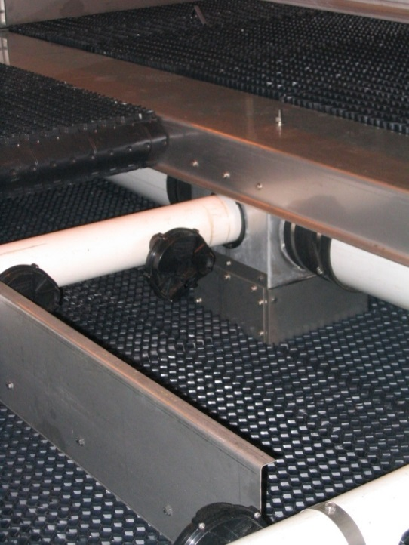
AT Induced Draft Counterflow Cooling Towers
Simplified Maintenance – Water Distribution
No Service Necessary from the Fan Deck
Fill Provides Safe Work Area for Maintaining Water Distribution System

Slide 34
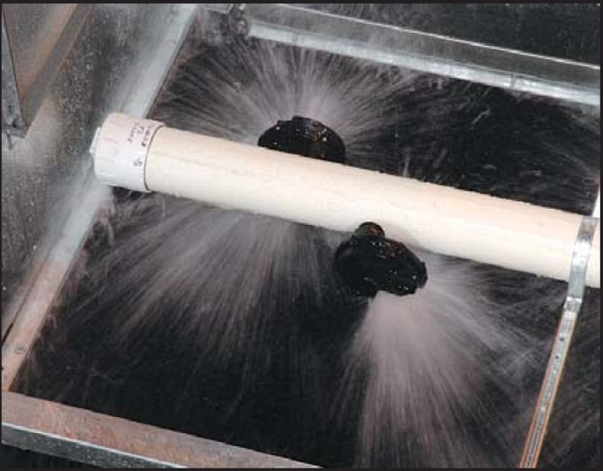
AT Induced Draft Counterflow Cooling Towers
Simplified Maintenance – Water Distribution
EvapJet Nozzles
Wide Opening: Prevent Clogging
Maximize Spray Area: Less Nozzles
Screw in Type

Slide 35
AT Induced Draft Counterflow Cooling Towers
Design Advantages – Water Distribution
Pressurized Water Distribution
Single Inlet Piping
Self Balancing – No Valves needed
No Hot Water Distribution Pans

Slide 36
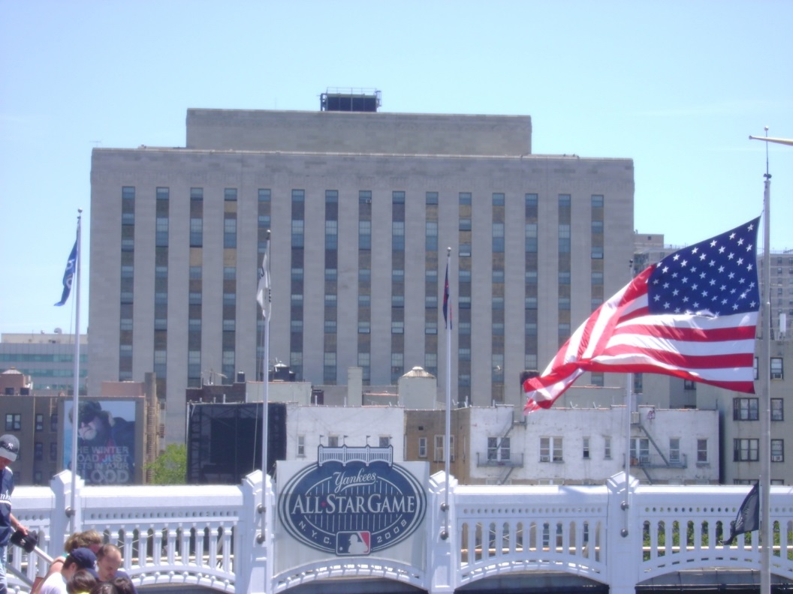
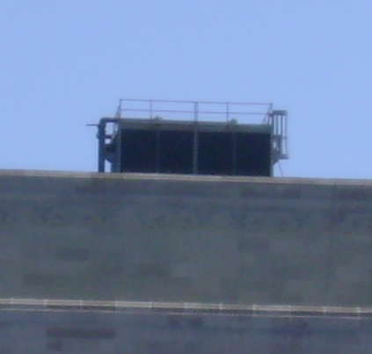
Design Advantages – Operating and Layout Weight
AT Induced Draft Counterflow Cooling Towers

Slide 37
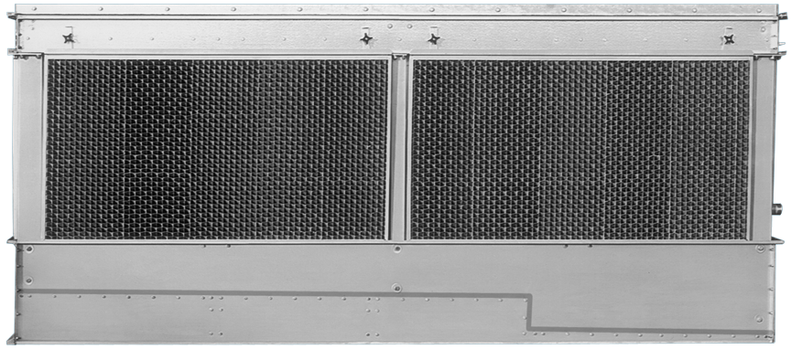
AT Induced Draft Counterflow Cooling Towers
Simplified Maintenance – Basin Area Access
‘Clean Pan’ Sloped Basin Design

Slide 38
AT Induced Draft Counterflow Cooling Towers
Design Advantage – Reduced Operating Weight
‘Clean Pan’ Sloped Basin Design
Reduces overall operating weight

Slide 39
AT Induced Draft Counterflow Cooling Towers
Signature Features – Unique Inlet Louvers
Two Pass Inlet Louver
Basin Enclosed - Not exposed to Wind & Sun
Angled Cross section “Sight-tight” design
Sunlight
Air Intake
Debris
Splashout

Slide 40
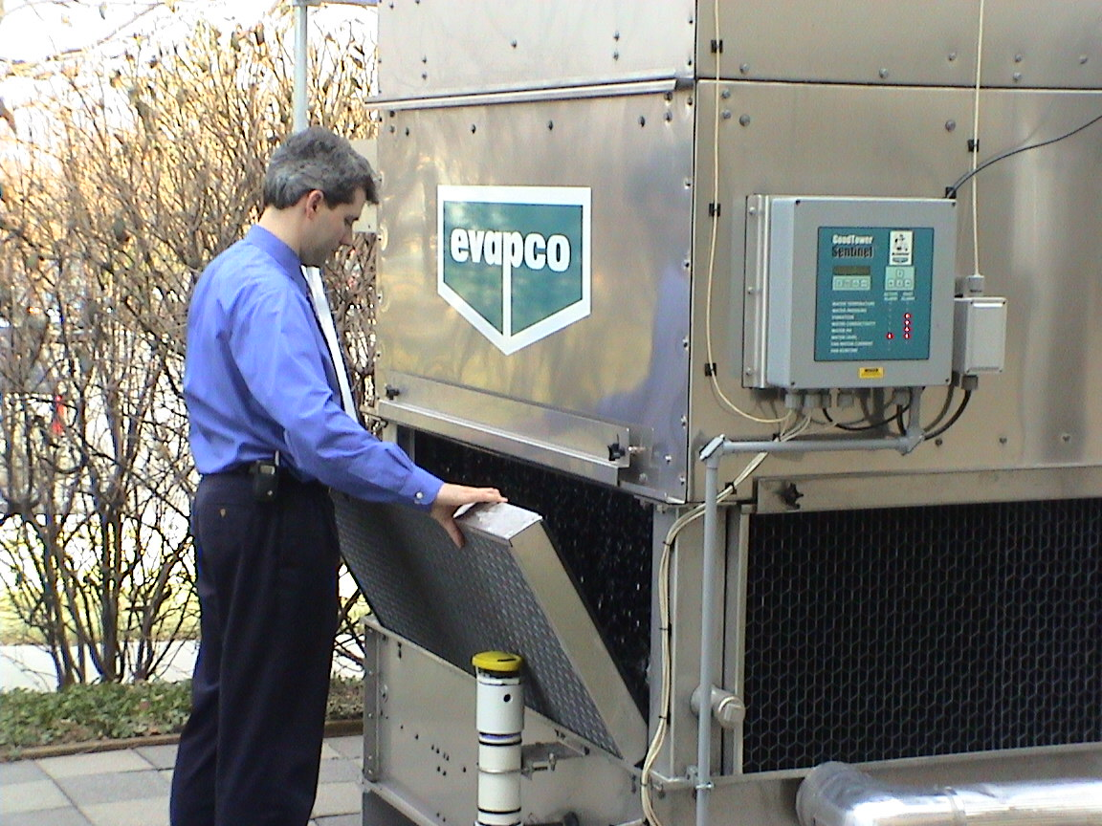
AT Induced Draft Counterflow Cooling Towers
Simplified Maintenance – Basin Area Access
Easily Removable Inlet Louvers for Full Basin Access
Can Be Performed from Outside Unit:
  Float Valve Adjustment
  Remove and Clean Strainers
  Clean Pan Bottom

Slide 41
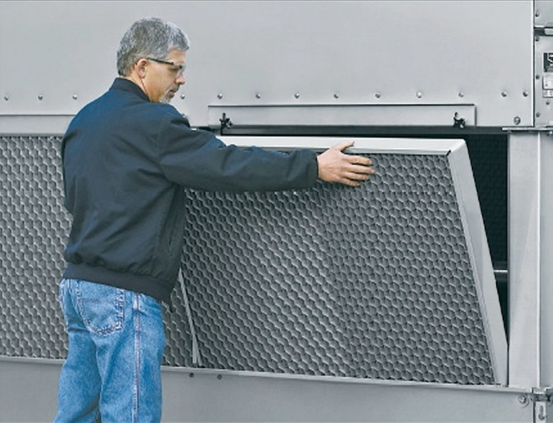
AT Induced Draft Counterflow Cooling Towers
Simplified Maintenance – Basin Area Access

Slide 42
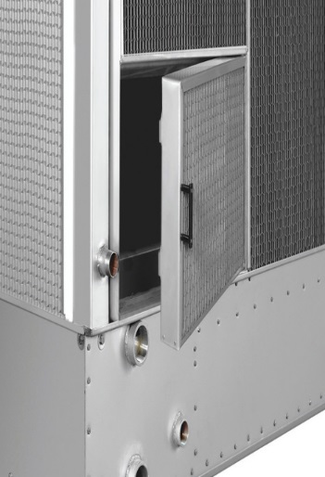
AT Induced Draft Counterflow Cooling Towers
Easy Maintenance – Louver Access Door
Allows easy access to perform routine maintenance and inspection of the makeup assembly, strainer screen and basin.
Hinged access panel with quick release mechanism.

Slide 43
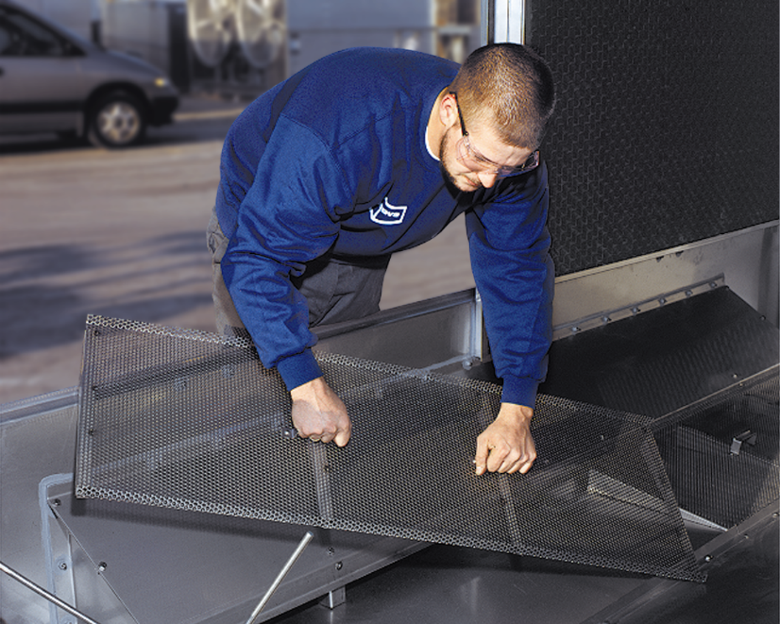
AT Induced Draft Counterflow Cooling Towers
Simplified Maintenance –Basin Area Access
Standard Stainless Steel Strainers

Slide 44
AT Induced Draft Counterflow Cooling Towers
Design Advantages – Layout
360° Air Intake
End Air Intake
Crossflow
Plan Area
Counterflow Tower
Net Free Area
Net Free Area
More Tower Area + More Air = Larger Plan Area
Less Tower Area + Less Air = Smaller Plan Area

Slide 45
AT Induced Draft Counterflow Cooling Towers
Design Advantages – Minimized Recirculation Potential
COUNTERFLOW
CROSSFLOW

Slide 46
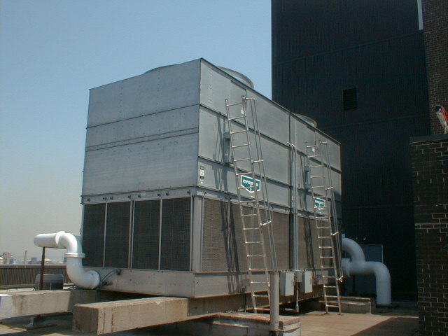
AT Induced Draft Counterflow Cooling Towers
Simplified Maintenance – Accessories
Sloped Ladders

Slide 47
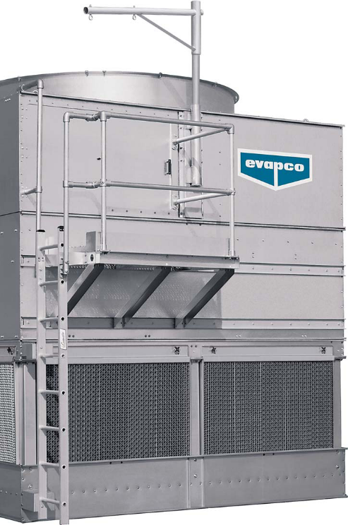
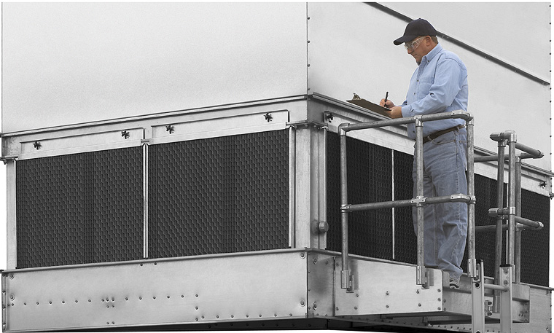
AT Induced Draft Counterflow Cooling Towers
Simplified Maintenance – Accessories
External Service Platform and Ladder
Motor Davit
Basin Level Platform

Slide 48
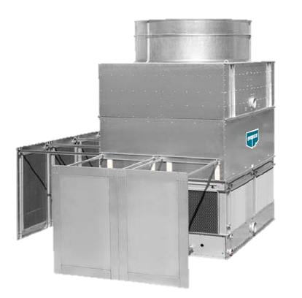
AT Induced Draft Counterflow Cooling Towers
Low Sound Solutions
CTI-certified options for reduced sound levels
  Discharge Attenuation
  Low Sound Fan
  Super Low Sound Fan
  Water Silencers
  Offset Inlet Walls
Notes:
Another complementary Low Sound Solution option to reduce sound levels is the new Discharge Attenuator.
(click)

Slide 49
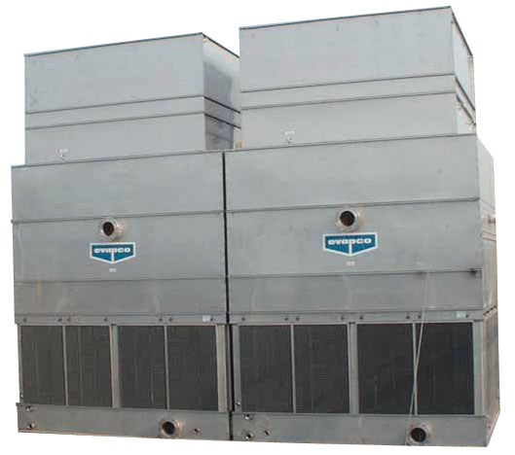
AT Induced Draft Counterflow Cooling Towers
Low Sound Solutions
Discharge Attenuation –Up to 10 dB(A) Reduction
Dimensional Impact
Straight sided discharge hood
Adds 1.400 mm to standard unit height
Construction
High density fiberglass insulated walls and low pressure drop baffling system
Thermal Performance
5% thermal performance derate
Notes:
The discharge attenuation is a straight sided discharge hood, which adds 55 inches (1400mm) to the unit height.
It is designed with high density fiberglass insulated walls, low pressure drop baffling and is self supporting.
There is a 2% thermal performance derate with the addition of the discharge attenuation package.
(click)

Slide 50
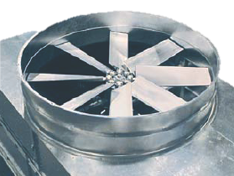
AT Induced Draft Counterflow Cooling Towers
Low Sound Solutions
Low Sound Fan – 4 to 7 dB(A) Reduction
Dimensional Impact
Adds 0 mm on most units
Adds 175 mm on large units
Available on all units except 1,2 m wide cells
Construction
Aluminum construction wide chord fan blades with steel fan hub
Thermal Performance
3.5% thermal performance derate
Notes:
The Low Sound Fan offers a 4 to 7 dB(A) reduction.
The Low Sound Fan is available on all 12’ and 14’ wide cells. This option adds 7 inches to cell height.
The Low Sound Fan is a wide chord design which employs aluminum blades and a steel fan hub design.
These features result in a fan able to move the required air flow at reduced fan speed.
Because we’re moving the same amount of air, there is no performance derate!
(click)

Slide 51
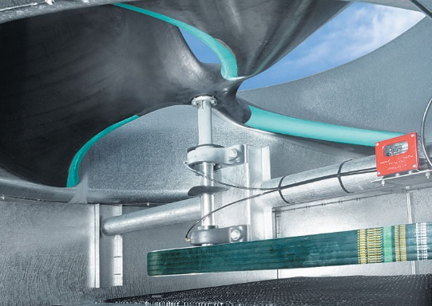
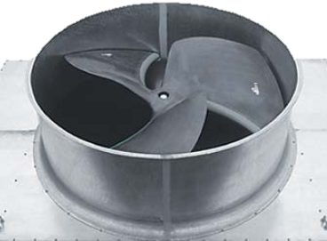
AT Induced Draft Counterflow Cooling Towers
Low Sound Solutions
SUPER Low Sound –Fan 9 to 15 dB(A) Reduction!
Dimensional Impact
Adds 330 mm to 530 mm to fan cylinder height
Available on all units except 1,2 m wide
Construction
Molded, heavy duty FRP construction
Extremely wide chord blades
Unique forward swept blade profile
Reduced fan speed
Thermal Performance
No thermal performance derate!
Notes:
The SUPER Low Sound Fan is available on all the 8.5’ wide cells.
This option adds 12 to 21 inches (250 to 530mm) to cell height, depending upon unit size.
SUPER Low Sound Fans are one piece molded construction utilizing heavy duty FRP. Please note, the fan hub is not a separate component.
This leading edge technology incorporates extremely wide chord blades with a unique forward swept blade profile.
This unique fan design results in a fan which is able to move the required air flow at significantly reduced fan speed.
Because we’re moving the same amount of air, there is no performance derate!
(click)

Slide 52
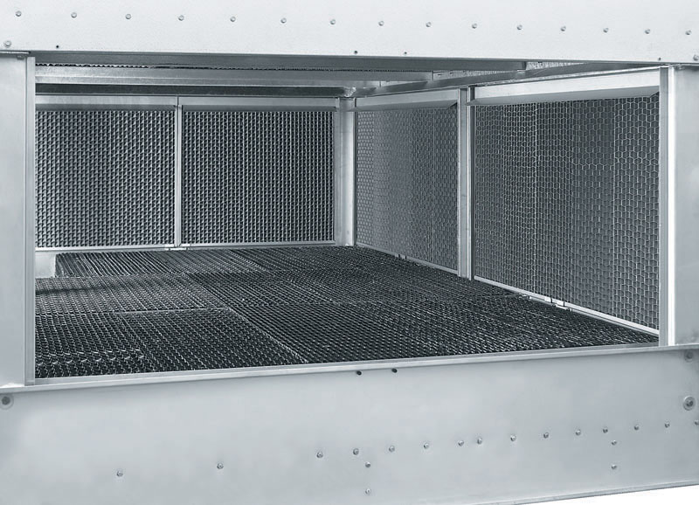
AT Induced Draft Counterflow Cooling Towers
Low Sound Solutions
Water Silencers - 4 to 7 dB(A) Reduction
Dimensional Impact
Available on all standard AT products
No dimensional impact
Construction
Lightweight PVC
Easily removable sections rest on steel supports
Located in the falling water area of the cold water basin
Thermal Performance
No thermal performance derate!
Notes:
Water Silencers are available on all standard AT products.
There is no dimensional impact for this option.
Water Silencers are constructed from lightweight PVC material and are provided in easily removable sections, which rest on steel supports
(CLICK)
Water Silencers are located in the falling water area of the cold water basin.
Because the water silencers are not directly in the air stream, there is no thermal performance derate.
(click)

Slide 53
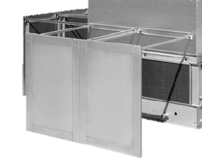
AT Induced Draft Counterflow Cooling Towers
Low Sound Solutions
Offset Inlet Walls- Typical 7 dB(A) Reduction
Dimensional Impact
Available on all standard AT products
Mounted 1,8 m away from air inlet louvers
Require external steel support (by others)
Used in conjunction with water silencers and SLSF
Construction
Galvanized Steel with acoustically lined baffles
Lateral support members for increased rigidity
Thermal Performance
No thermal performance derate!
Notes:
Water Silencers are available on all standard AT products.
There is no dimensional impact for this option.
Water Silencers are constructed from lightweight PVC material and are provided in easily removable sections, which rest on steel supports
(CLICK)
Water Silencers are located in the falling water area of the cold water basin.
Because the water silencers are not directly in the air stream, there is no thermal performance derate.
(click)

Slide 54
LSTE
Forced Draft
Counterflow Cooling Towers

Slide 55
LSTE Models And Nomenclature
LSTE Forced Draft Counterflow Cooling Towers
Centrifugal Fan Design
10 Box Sizes
145 – 5.930 kW

Slide 56
LSTE Models And Nomenclature
LSTE Forced Draft Counterflow Cooling Towers
LSTE 10524
LST | - | Low Sound Tower
E | - | Product Version
10 | - | Width of Unit (feet)
5 | - | Capacity Designator
24 | - | Lenght of Unit (feet)

Slide 57
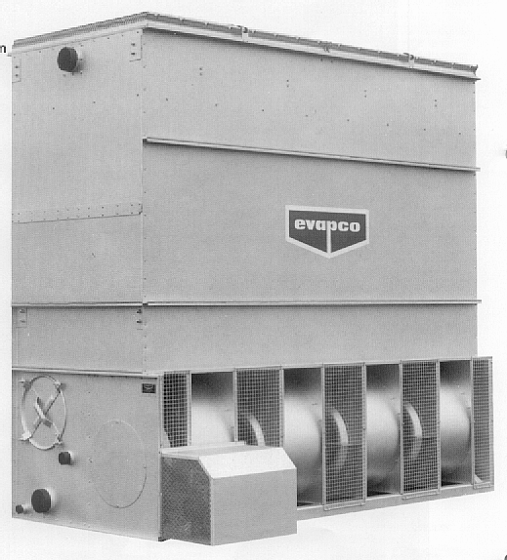
LSTE Forced Draft Counterflow Cooling Towers
Fan Motors – LSTE 1.6m Wide Towers
TEFC motors designed for cooling tower applications
Motor mounted outside of unit on adjustable base
Easy to adjust belt tension or change motor

Slide 58
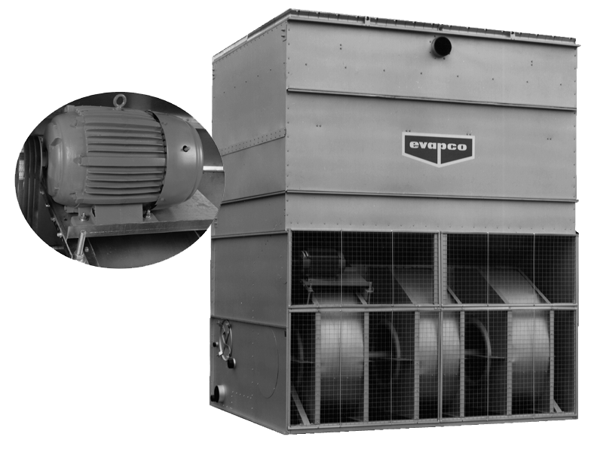
LSTE Forced Draft Counterflow Cooling Towers
Fan Motors – LSTE 2.4m and 3m Wide Towers
TEFC motors designed for cooling tower applications
Motor mounted in open area on adjustable base
Easy to adjust belt tension or change motor

Slide 59
LSTE Forced Draft Counterflow Cooling Towers
EVAPCO Corrosion Protection System
Standard Materials
Z-725 Hot-Dip
Galvanized Steel
PVC Spray Distribution
System
PVC Drift Eliminators
Stainless Steel Strainers

Slide 60
LSTE Forced Draft Counterflow Cooling Towers
Optional Materials of Construction
304L or 316L Stainless Steel Construction
Different Options:
  Cold Water Basin
  Water Touch Unit
  Complete Construction

Slide 61
LSTE Design And Construction
LSTE Forced Draft Counterflow Cooling Towers
One Piece “Forged Journal” Shaft
  Eliminates “Tack Welded Journals”
  Increases Shaft Life

Slide 62
EVAPAK® Fill – A Working Platform!
LSTE Forced Draft Counterflow Cooling Towers
Bonded Fill Bundles with Bottom Supports make EVAPAK® Fill an Ideal Working Platform
Provides “Safe” Work Area to Perform Maintenance on Spray Distribution System

Slide 63
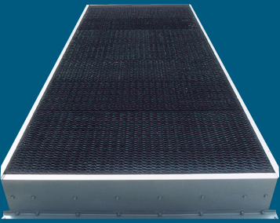
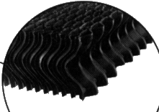
LSTE Forced Draft Counterflow Cooling Towers
PVC Drift Eliminators
Efficient Drift Control – 0,001%
Easy to Handle,
Lightweight Framed Sections
Non-Corrosive PVC

Slide 64
LSTE Forced Draft Counterflow Cooling Towers
Stainless Steel Strainers
Corrosion Resistant
Eliminates Expensive Maintenance Caused by “Corroded” and “Collapsed” Galvanized Strainers

Slide 65
LSTE Design And Construction
LSTE Forced Draft Counterflow Cooling Towers
PVC Water Distribution System
Non-corrosive Spray Header & Nozzles
Threaded Nozzles Eliminate Troublesome “Rubber Grommets”
Large 25 mm Nozzle Opening and Anti-sludge Ring Reduces Clogging
Self-balancing, Pressurized
Sludge Ring
Debris

Slide 66
LSTE Design Advantages
LSTE Forced Draft Counterflow Cooling Towers
Indoor Installations with External Static Pressure-Centrifugal Fan Design
Sound-Attenuation Available on Centrifugal Fan Design

Slide 67
LSTE
CUSTOMER BENEFITS

Slide 68
LSTE Forced Draft Counterflow Cooling Towers
Very Quiet Operation
Centrifugal fans
Single sided air entry
Optional intake and discharge attenuation

Slide 69
LSTE Forced Draft Counterflow Cooling Towers
Easy Maintenance
Easy access motors
Fan and drive components easily accessible
Large circular access doors located by float valve and strainer assembly
Non-corrosive PVC fill, eliminators, and water distribution system
Fill can be used as working platform

Slide 70
LSTE Forced Draft Counterflow Cooling Towers
Applications
Ducted indoor layouts
Replacement tower
Noise sensitive applications
Low height

Slide 71
EVAPCO EUROPE BVBA
Taking
Quality
and
Service
to a
Higher Level . . .

